Slide 1
MOTIVATION THEORIES
Dr. Syed Ghufran Hashmi
Assistant Professor
IIIT Sonepat

Slide 2
TWO IMPORTANT THEORIES OF MOTIVATION
MASLOW
HERZBERG

Slide 3
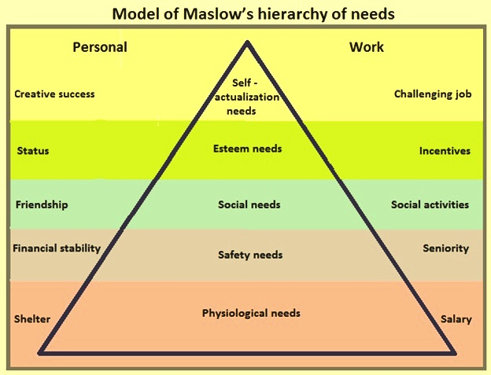
MASLOW’S HIERARCHY OF NEEDS

Slide 4
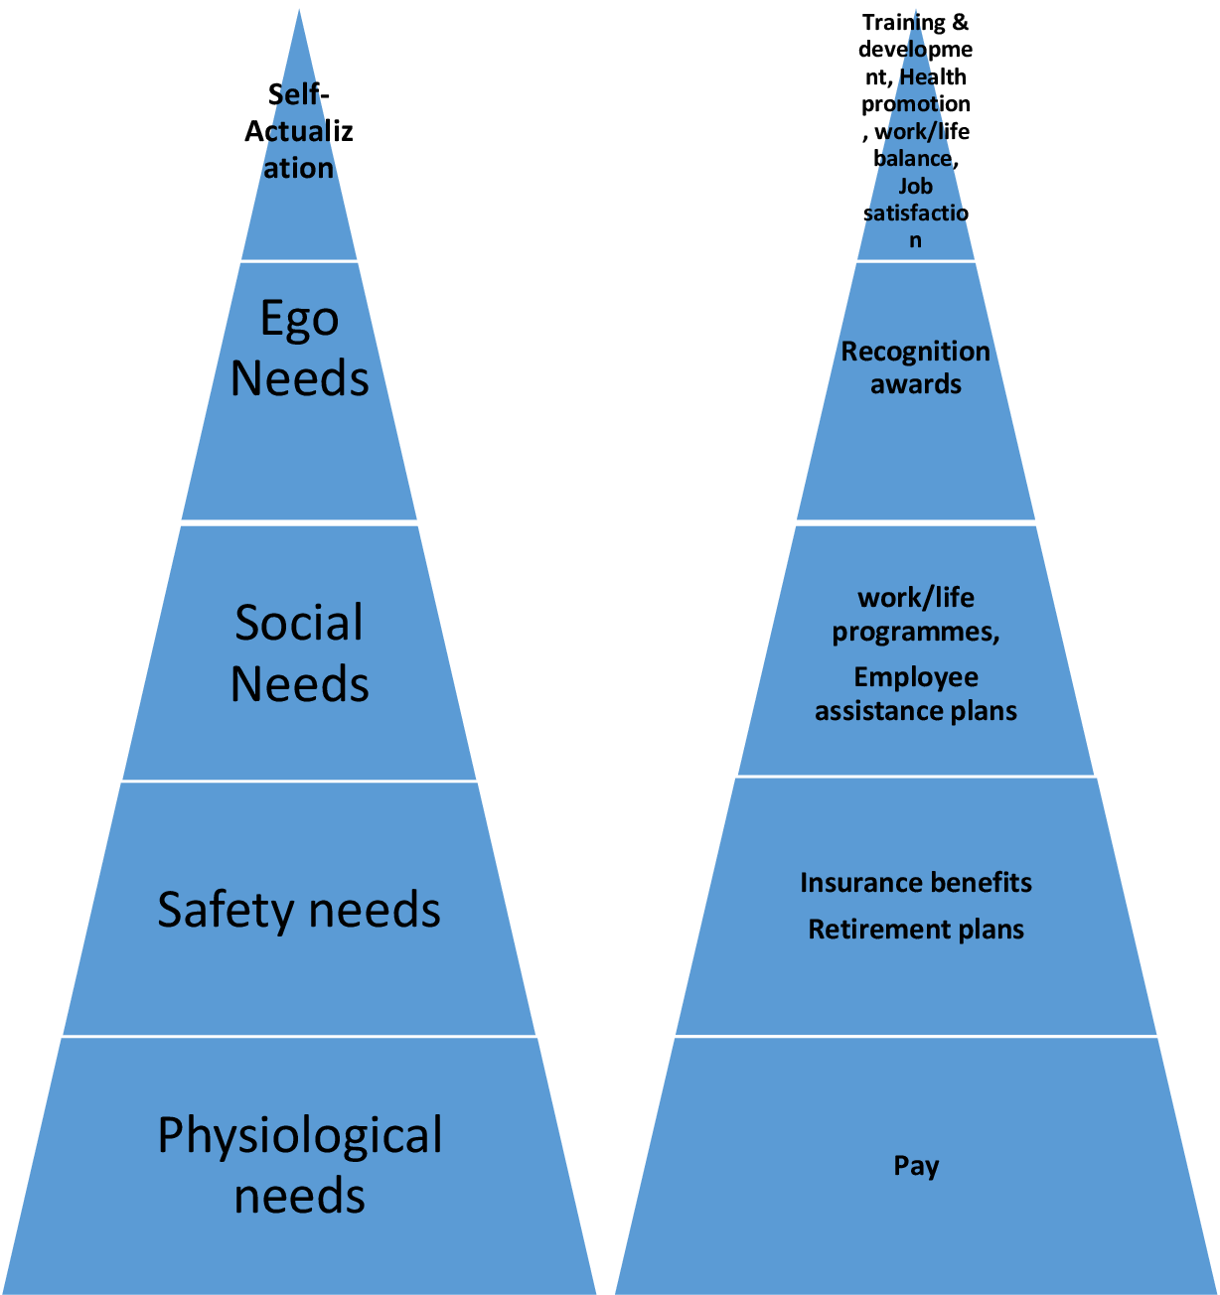
COMPARISION IN AN ORGANISAIONAL SETTING

Slide 5
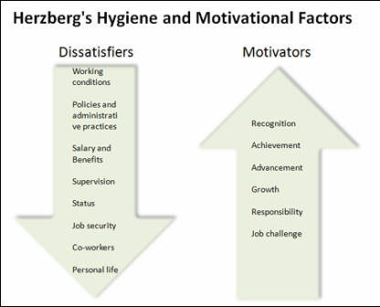
HERZBERG’S TWO FACTOR THEORY

Slide 6
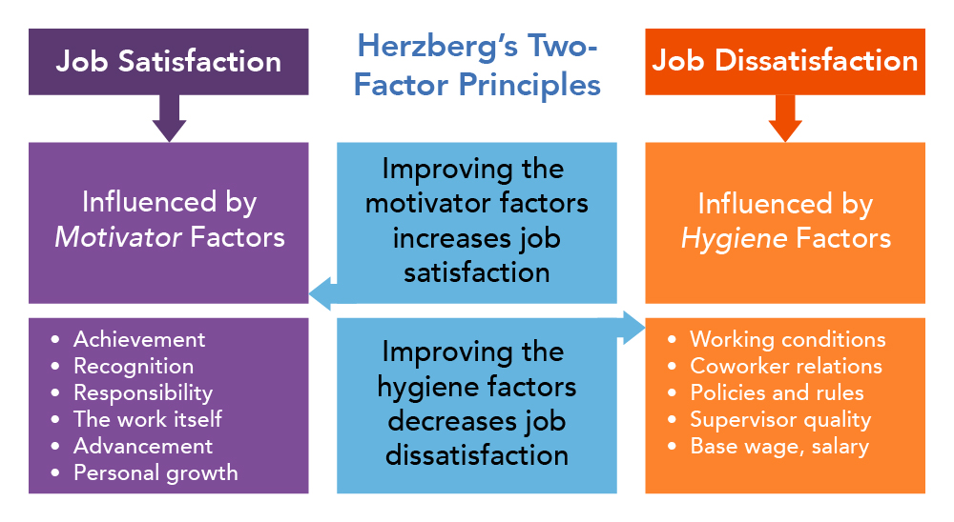
HERZBERG

Slide 7
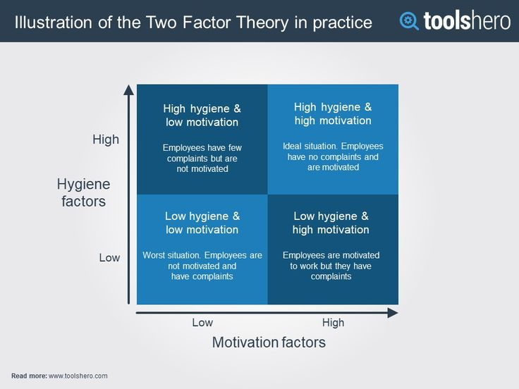
HERZBERG

Slide 8
VISUAL COMMUNICATION
Gestalt Theory
Semiotics
Constructivism
Ecological Theory
Cognitive Theory
Huxley-Lester Model

Slide 9
Gestalt Theory
The sum is greater than its parts. We are capable of mentally assembling separate objects into a seemingly logical new whole.
Four ways in which we make these associations:

Slide 10

Proximity
The closer objects are to each other, the more likely they will form a larger whole.

Slide 11

Similarity
The more objects resemble each other, the more they will assemble.

Slide 12
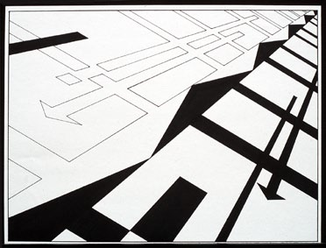
Continuation
Our eyes are inclined to follow lines and curves, so if objects are arranged along paths then we perceive a larger construct and also a sense of movement.

Slide 13

Closure
In the process of trying to identify things we’re looking at, our brains will close incomplete shapes and patterns.

Slide 14
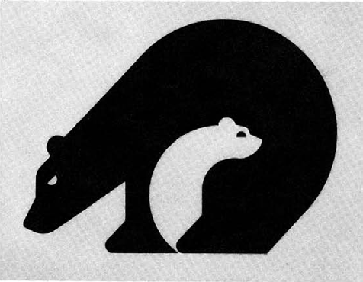
Figure/ground relationship
A state of gestalt is achieved when all the elements of your design seem to belong together. For this to happen, then the positive and negative areas of your design also need to work together: This is called the figure/ground relationship.

Slide 15


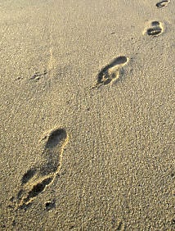
Semiotics
The science of signs and
symbols. Three kinds:
• Iconic: It resembles what it signifies.
• Symbolic: Its association has to be learned.
• Indexical: It suggests a
causal or other connection
to something else, such as an event.

Slide 16
Constructivism
When we look at anything, we have to piece it together. We do this through a series of rapid eye movements that assemble a blueprint of what we’re looking at, while at the same time comparing the results to memory and past
associations. So, in effect, we
construct images out of many
narrowly focused observations.

Slide 17
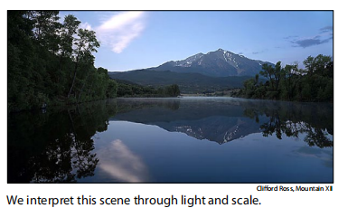
Ecological Theory
We interpret what we see through spatial properties in the environment: Surface layout, composition, lighting, motion, gradation, shape, size, solidity and scale.Light — the way it reveals the three_x0002_dimensionality of objects, and scale — the
way objects diminish as they recede from us — are the two most important properties
that we use to interpret space.

Slide 18
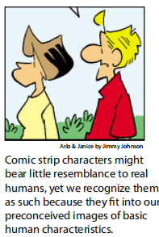
Cognitive Theory
Perception is not just the result of visual stimuli, but involves a series of mental processes in which we compare what we see to our catalog of memories and perceptions and use those to interpret and analyze. In other words, we understand what we’re looking at most easily by comparing it to what we’re familiar
with.
We are constantly on the lookout for things with which we’re familiar. So we see, for example, faces in inanimate objects simply because some features look vaguely like eyes and a mouth, such as the man in the moon.

Slide 19
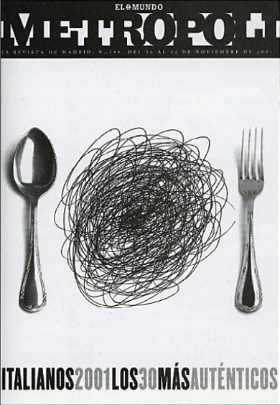
Huxley-Lester Model
Sight and thought are inseparable. We go through cycles of perceiving,
focusing on particular things we see, learning from that and committing it to
memory and then applying that knowledge to what we perceive. The more knowledge and experience you gain, the easier it is to interpret what you’re looking at. So, “the more you know, the more you see.
We apply our experience of a
plate of spaghetti to the scribbled
lines and make the association in
our perception of this magazine
cover. Without the spoon and
fork however, we probably
wouldn’t make the connection.

Slide 20
THANK YOU

